Slide 1
Mini Project 2
Random Walker on a
Random Network
PSU REU · Graphs & Networks
Cover Time
Undirected
Python + NetworkX
300
Project Question
Graph Type
Language
Trials per test
Notes:
Welcome. 12 slides answering all five core project questions backed by real simulation data.

Slide 2
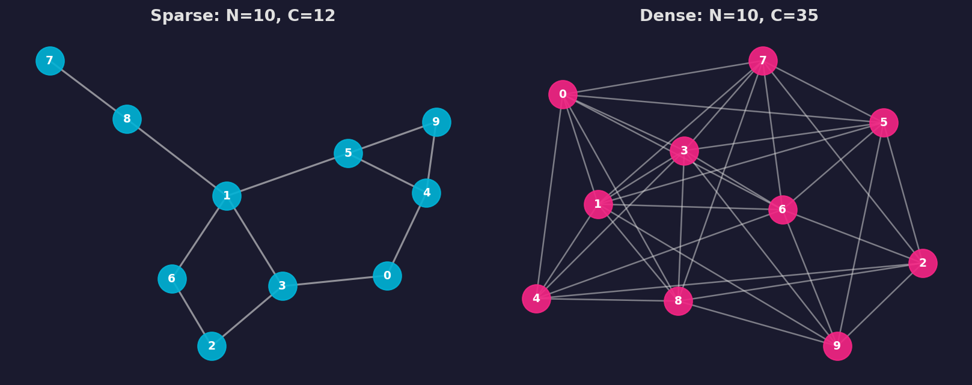
What Is a Random Graph?
N nodes · C edges · Undirected · No self-loops
📌 Max possible edges for N nodes:
C_max = N(N–1)/2
📌 Minimum for connected graph:
C_min = N – 1 (spanning tree)
📌 No self-loops or
duplicate edges allowed
Notes:
A random undirected graph: N nodes, C randomly placed edges. No self-loops.

Slide 3
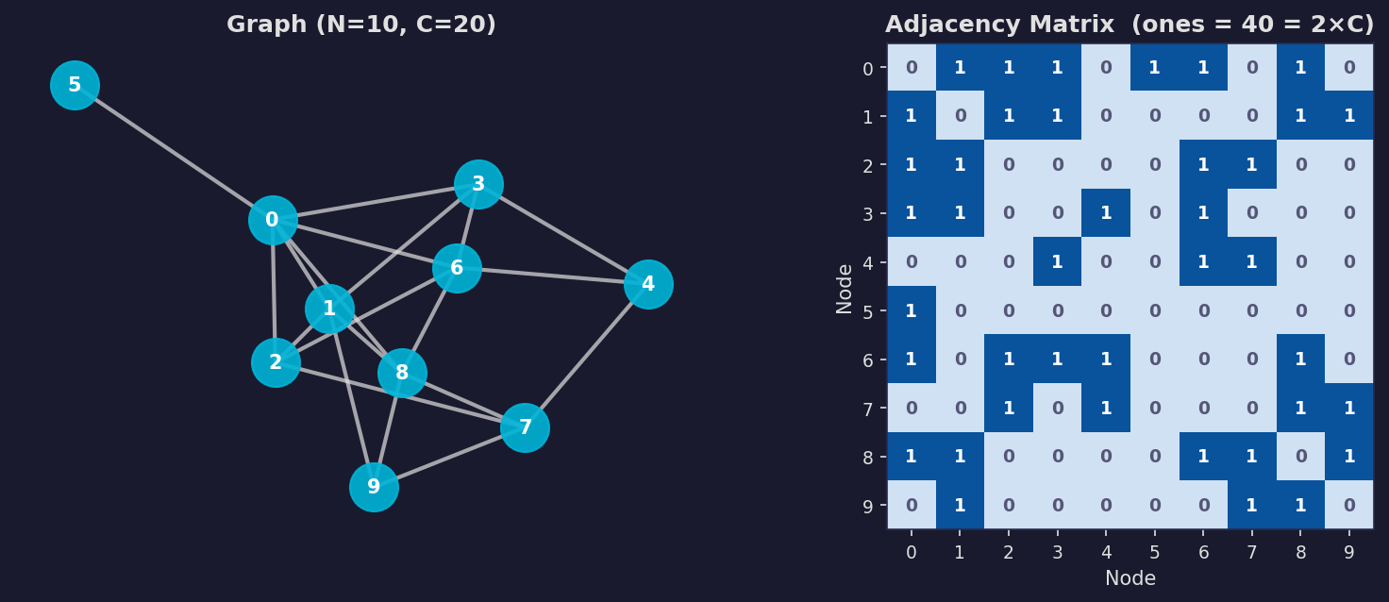
Representing the Graph: Adjacency Matrix
A[i][j] = 1 if nodes i and j are connected
A[i][j] = 0 if no edge exists between i and j
2 × C ones total each edge appears twice (symmetric matrix)
Notes:
Adjacency matrix: NxN, 2C ones total for an undirected graph.

Slide 4
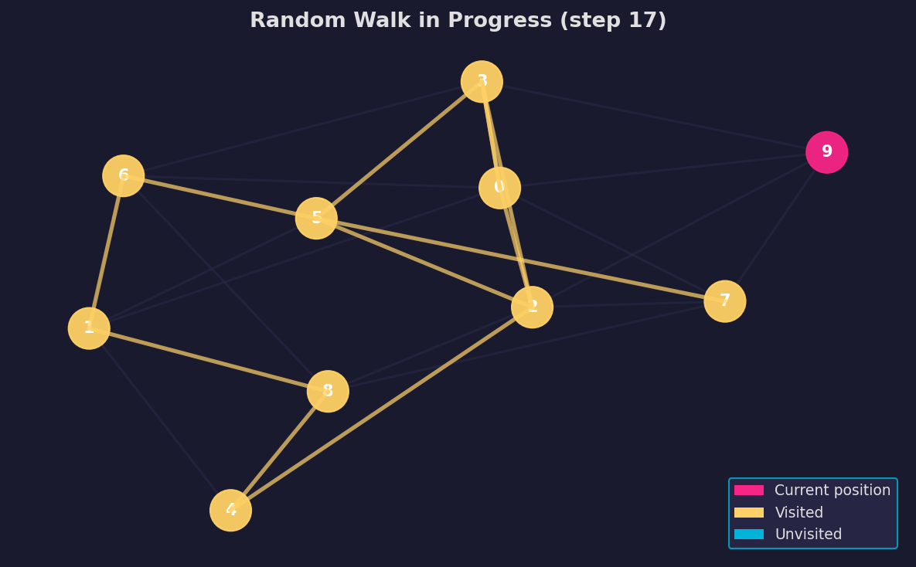
How the Random Walk Works
1
Start at a random node
2
Look up neighbors in adjacency matrix
3
Hop to one random neighbor
4
Mark node as visited
5
Repeat until ALL nodes visited
6
Record total steps = cover time
⚠ Prerequisite
The graph must be connected — every node reachable
from every other node.
Notes:
Cover time = steps until every node visited. The graph must be connected.

Slide 5
Q1 — Average Visiting Time
HOW LONG DOES IT TAKE?
N=10, C=20
N=20, C=60
N=30, C=90
Random walker
Random walker
Random walker
~40
~102
~230
steps
steps
steps
Smart: ~13 (3.1×)
Smart: ~25 (4.1×)
Smart: ~47 (4.9×)
Key insight: Cover time scales as O(N²) for the random walker and O(N log N) for the smart walker — and the gap widens with N.
Notes:
Q1 direct answer: how long does it take? For small sparse graphs the cover time is tens of steps; it grows roughly as N-squared as graphs get bigger. The smart walker cuts this to O(N log N) — and the advantage grows as N increases.

Slide 6
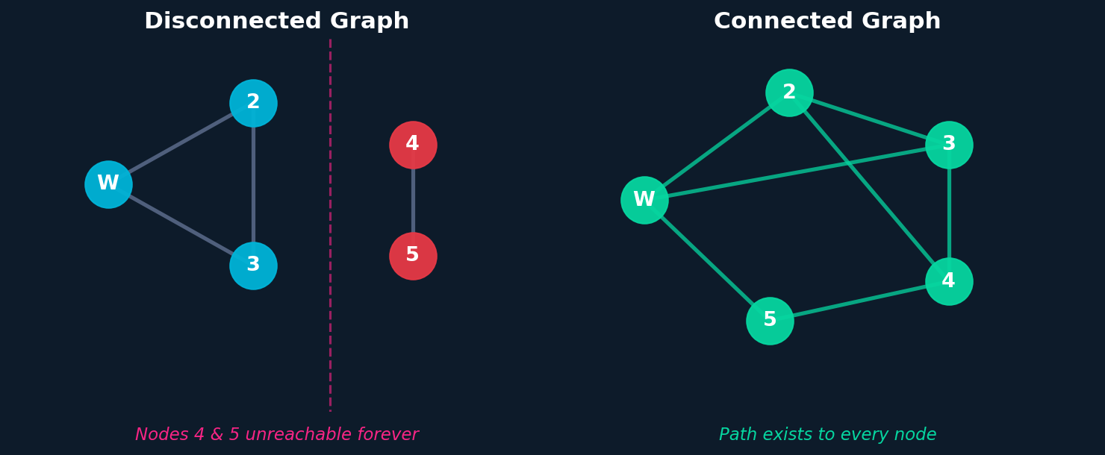
Q2 — Network Prerequisites
WHAT MUST THE NETWORK SATISFY?
Connectivity is required
1
If any component is isolated, the walker is permanently trapped and can never visit all nodes.
VS
Phase transition
2
Adding random edges causes a sharp jump: below a critical density graphs are mostly disconnected; above it, mostly connected.
Practical recommendation
3
Use C ≥ 2N edges for reliable connectivity — well above the theoretical minimum.
Prerequisite: The graph must be connected — every node reachable from every other node.
Notes:
Q2: the graph must be connected. Disconnected = infinite cover time. C >= 2N is a safe practical rule.

Slide 7
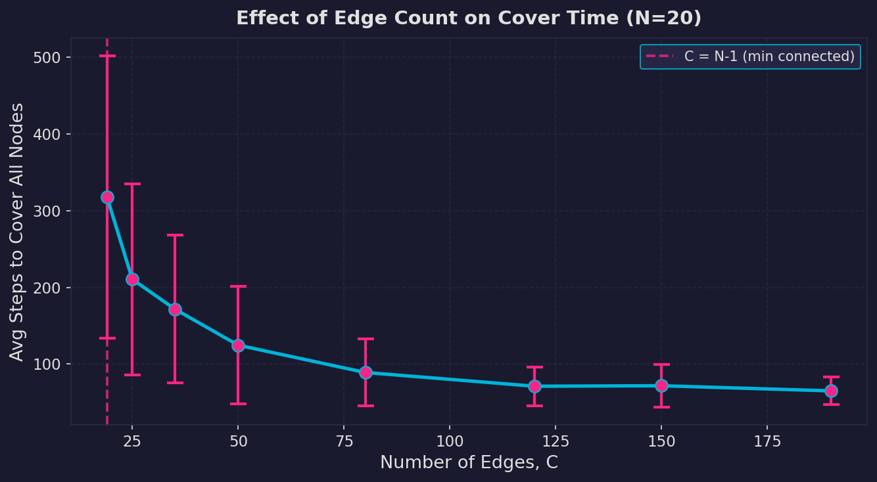
Experiment 1: Effect of Edge Count C
N = 20 nodes fixed · 300 trials per C value
Sparse graphs (C near N-1)
Cover time spikes to 318 steps — walker constantly retraces paths
Dense graphs (C near C_max)
Cover time drops to ~65 steps — many shortcuts, fast coverage
Diminishing returns
Gains shrink as C grows: adding edges past C ≈ 80 gives little benefit
Critical: C = N−1 = 19 (min connected)
Notes:
More edges = lower cover time, steeply at first then diminishing returns.

Slide 8
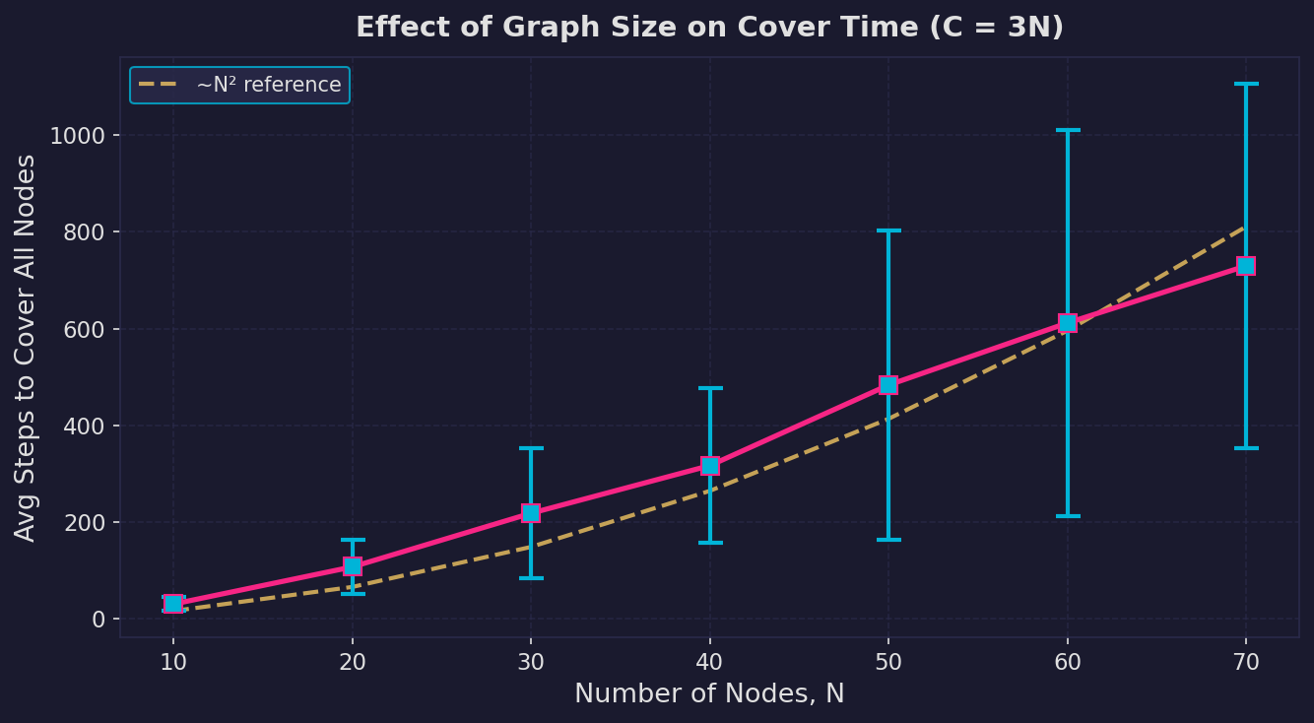
Experiment 2: Effect of Graph Size N
C = 3N (sparse but connected) · 300 trials per N value
N
C
Avg Steps
10
30
31
20
60
108
30
90
218
50
150
483
70
210
729
Scaling Law
Cover time grows roughly as N²
(yellow dashed reference curve).
Doubling N ≈ quadruples the time.
Notes:
Cover time grows ~N². Doubling N quadruples the steps.

Slide 9
Critical Value of C: When Does Coverage Become Possible?
C < N−1
C = N−1
(Spanning Tree)
C ≫ N−1
→
→
DISCONNECTED
Walker stuck
Just connected
High cover time
Well connected
Fast coverage
Hard Limit: C_min = N − 1
At C = N − 1 (Spanning Tree)
Rapid improvement: N−1 < C < 3N
Diminishing returns: C > 4N
Below this threshold the graph is disconnected and cover time is mathematically infinite.
Graph is barely connected. One bridge removal breaks it. Cover time is extremely long.
Each added edge creates new paths. Cover time drops steeply — highest return per edge.
The graph is already well connected. Extra edges provide marginal speed improvement.
Notes:
Critical value = N-1. Below: infinite cover time. Above: rapid gains then diminishing returns.

Slide 10
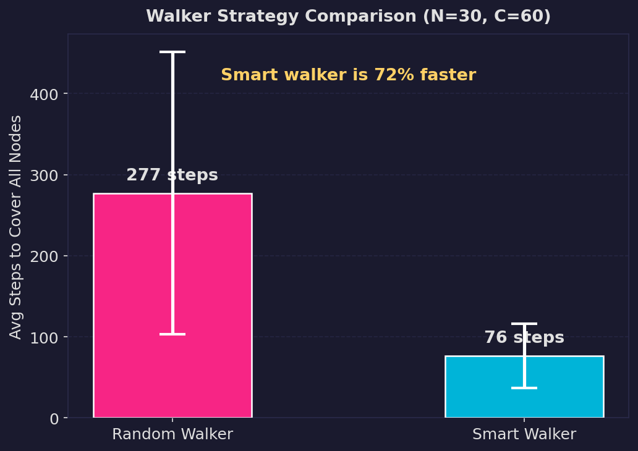
Improving the Walker: Memory-Guided Strategy
Random Walker
Smart Walker
Strategy
Pick any neighbor
Prefer unvisited
Memory
None
Tracks visited
Avg Steps
277
76
Speedup
—
3.6× faster
Smart Walker Logic
unvisited = [n for n in neighbors
if n not in visited]
if unvisited:
hop to
random(unvisited)
else:
hop to
random(all neighbors)
Notes:
Smart walker: prefer unvisited neighbors. 3.6x speedup.

Slide 11
Summary: All Questions Answered
Q1
How long to visit every node?
N=10,C=20: ~40 steps random / ~13 smart. Scales as O(N²) vs O(N log N).
Q2
What prerequisite must the network satisfy?
The graph must be connected (C ≥ N−1). Disconnected graphs have infinite cover time.
Q3
How does cover time scale with N and C?
Grows ~N² as N increases (fixed density). Decreases as C increases (more edges = faster).
Q4
What happens when C is lowered? Critical?
Cover time rises sharply. Critical: C = N−1 (spanning tree). Below this: impossible.
Q5
How to improve walker efficiency?
Smart walker: prioritize unvisited neighbors. 3.6× faster (277 → 76 steps).
Notes:
All five Q&As on one slide for quick reference.

Slide 12
Code Architecture
Python + NetworkX · Follows Sayama Chapter 15 Style
create_random_graph()
smart_walk_cover_time()
1
6
N nodes + C random edges, no self-loops
Prefers unvisited neighbors; falls back to random
create_connected_graph()
average_cover_time()
2
7
Retries until nx.is_connected() = True
Runs N trials, returns mean and std deviation
show_graph()
experiment_vary_C()
3
8
NetworkX spring layout visualization
Fixed N, sweeps C values, plots error-bar chart
show_adjacency_matrix()
experiment_vary_N()
4
9
nx.to_numpy_array() — shows 2C total ones
C = k·N, sweeps N values, plots scaling curve
random_walk_cover_time()
experiment_compare_walkers()
5
10
Simulates pure random walker; returns steps
Bar chart: random vs smart walker strategies
Notes:
10 clean modular functions following Sayama Chapter 15 style.

Slide 13
Key Takeaways
Random Walkers Reveal
Network Structure
🔗 Connectivity is essential — no coverage below C = N−1
📉 More edges → lower cover time (sharply at first)
📈 Larger graphs → much longer cover time (~N² scaling)
🧠 Memory (smart walker) gives 3.6× speedup over pure random
Built with Python · NetworkX · Sayama Ch. 15 Style · PSU REU 2026
Notes:
Four key findings map to the four project questions.

